Slide 1
Group 6 Project
English Good Good + English Bad Bad TEAM
( EggEbb Team)
Notes:
Now I want to introduct

Slide 2
Outline
01
Team Introduction
04
Flowchart
02
Ideation
05
Low Fidelity Model
03
Science Behind

Slide 3
Team Member
01
Jing-Song Chang
PTT analysis,low fidelity model
02
Yu-Chieh Lin
Dcard analysis, ideation
03
Shih-Yu Wang
APP Store analysis, science behind
04
Hsiao-Ting Lai
Google Play Store analysis, flow chart

Slide 4
Unimaginable Super Magic App
Give you what you want by easy way,
even your grandma knows how to use it.

Slide 5



Ideation
“
App name：
ePost App 2.0
Goal：
Improve Chunghwa Post’s older version of the App
- make sure that no one has difficulties in managing
their own account.
“
e動郵局
Security App
Notes:
現代人過於忙碌，沒有時間親自到郵局處理帳戶問題，因此郵局推出了APP，使用戶可以透過網路查看自己的帳戶，但此APP因設計不良，造成操作困難，因此我們這組這次的目的就是要改善這款APP，提高使用率。

Slide 6
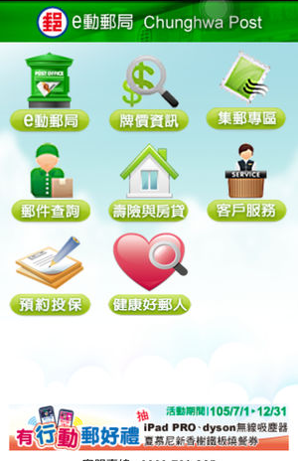
Science Behind
User comments from four social platforms
Google play, App Store, PTT, Dcard
Product use problem
Login problem
Transaction problem
Interface unpractical
Network connection problem

Slide 7
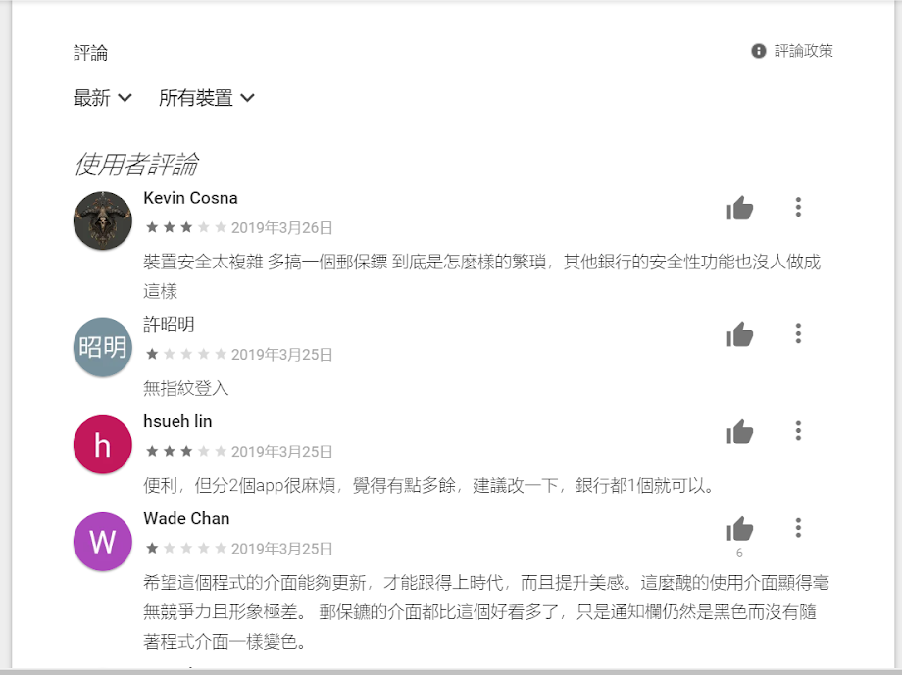
Google Play store Analysis
Total: 100 comments

Slide 8
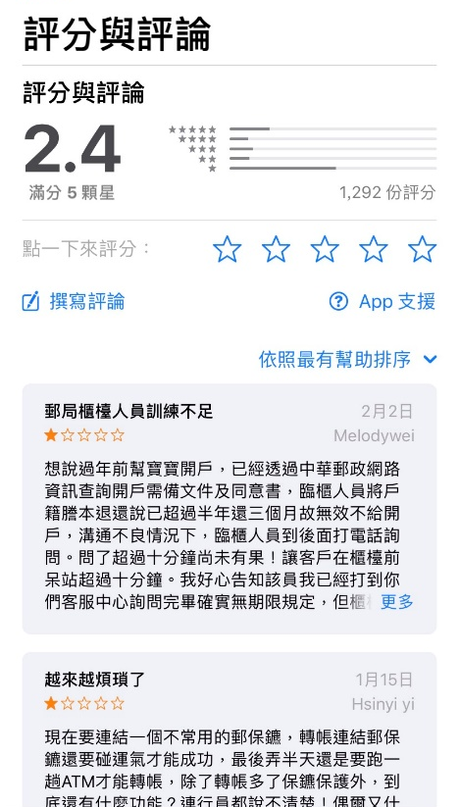
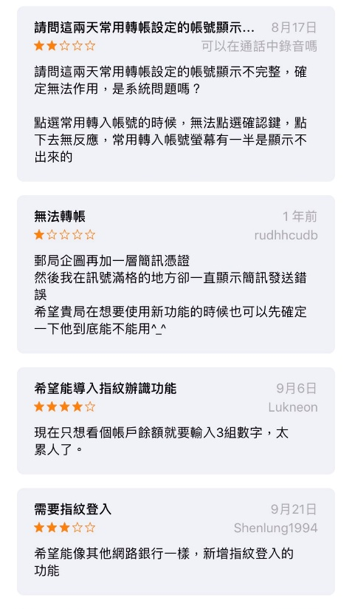
Apple app store Analysis
Total: 207 comments

Slide 9
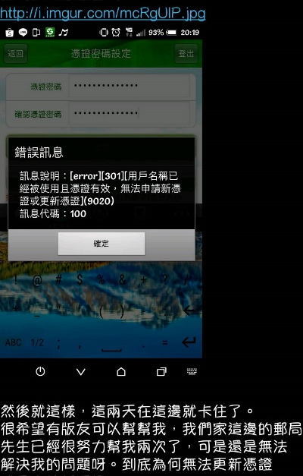
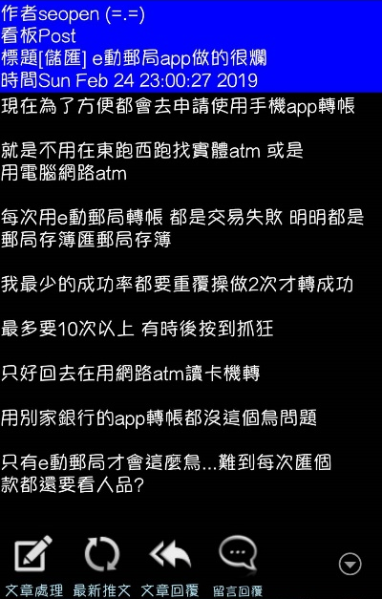
PPT Analysis
Total:134 comments

Slide 10
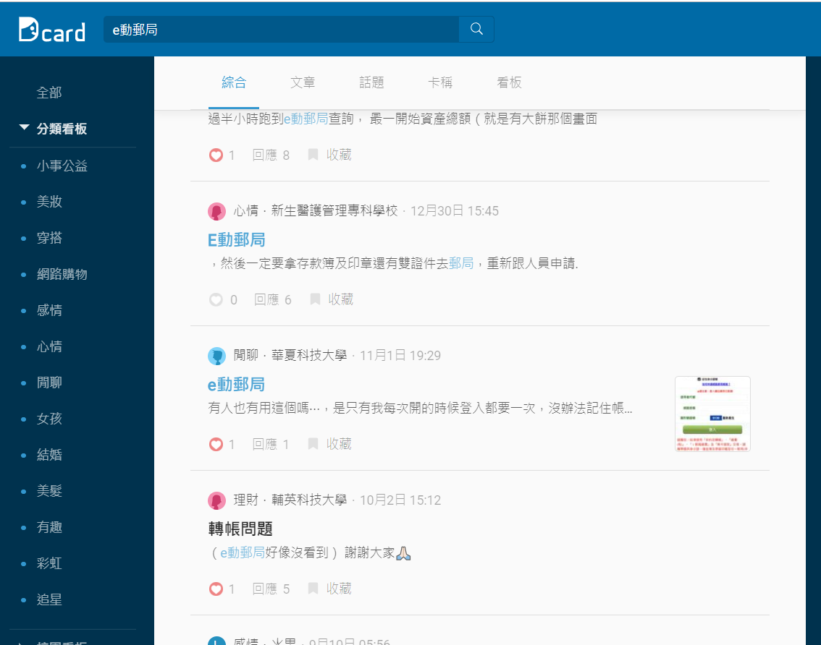
Dcard Analysis
Total: 104 comments

Slide 11
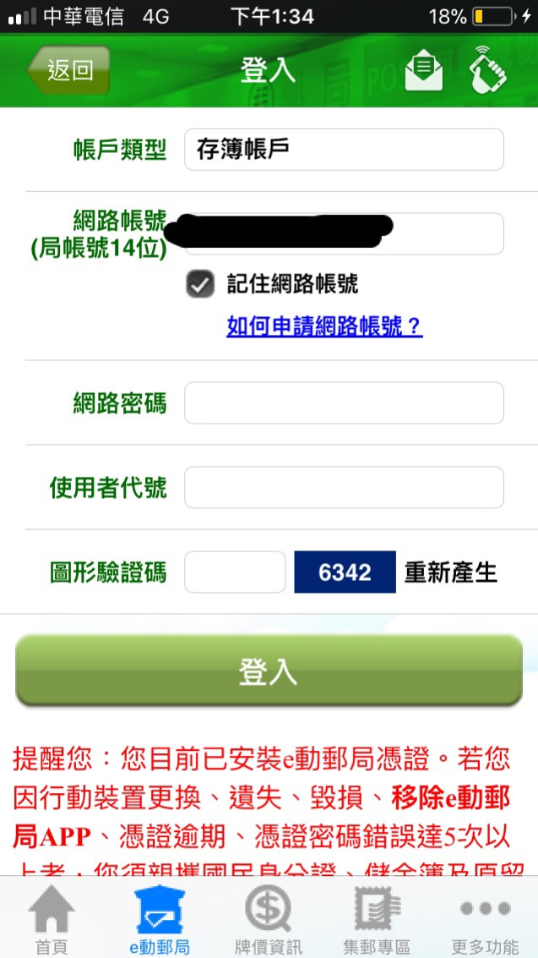
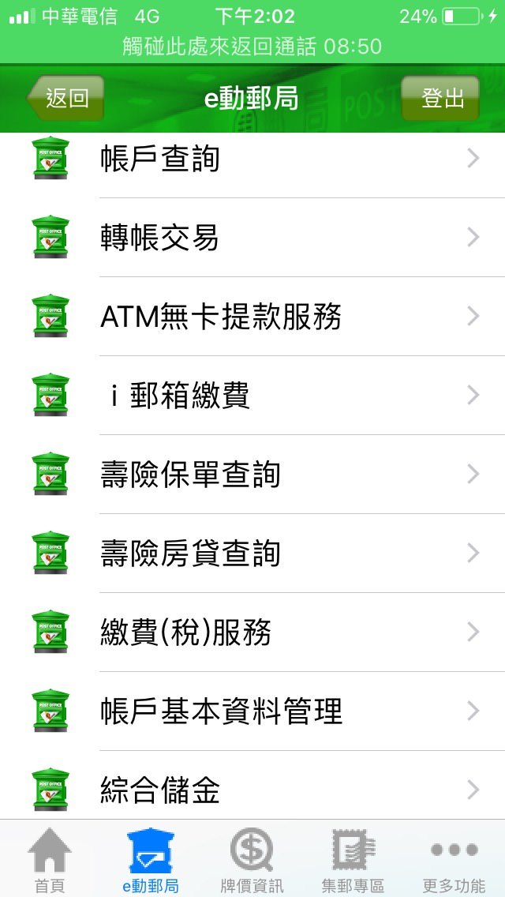

The Login Screen
Three types of
ID to enter

Slide 12
Flow chart
First Time Login
Using account & password
Success
Select the
Quick Login
Go to the
post office
in person
Yes
No
Account rescue
Using
account
&password
Quick Login
Fingerprint
Pattern
Face ID
Fail for
3 times
Login
Using account& password
Fail
Account
Frozen
Send a
Warning Email
Success
Success
Success
Send a notified Email
Login Successfully

Slide 13
Low Fidelity Model

Slide 14


Account:
Please enter account name
Password:
Please enter password
Quick Login
Enter

Slide 15



Fingerprint
Facial
Recognition
Pattern

Slide 16


Slide 17
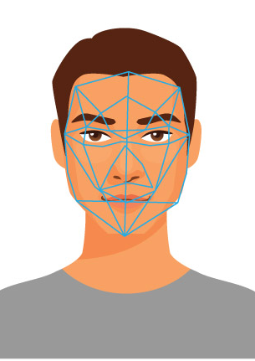

Slide 18
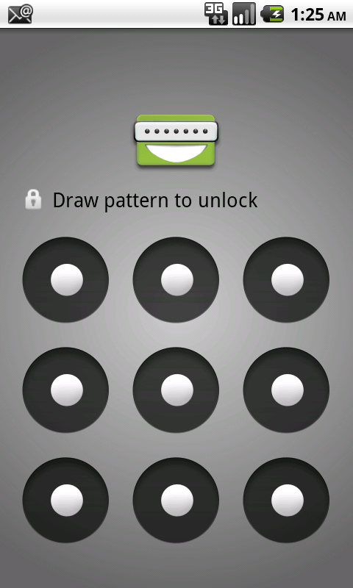

Slide 19

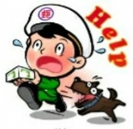
return
Warning email
Login Failure

Slide 20

return
Login notification
Login Successful

Slide 21
Thank you

